Slide 1

EDS + FIREFLY API
From prompt
to publish.
A simple idea for the contributor.
A reusable integration pattern for the customer.
Prompt → Firefly → DAM → EDS
TENNIS CLUB
Notes:
[Sources]
User-provided tennis generated hero image: /mnt/data/eds_firefly_work/tennis-generated-hero.png
Story framing based on user-provided EDS + Firefly use-case and implementation decks.
[/Sources]

Slide 2
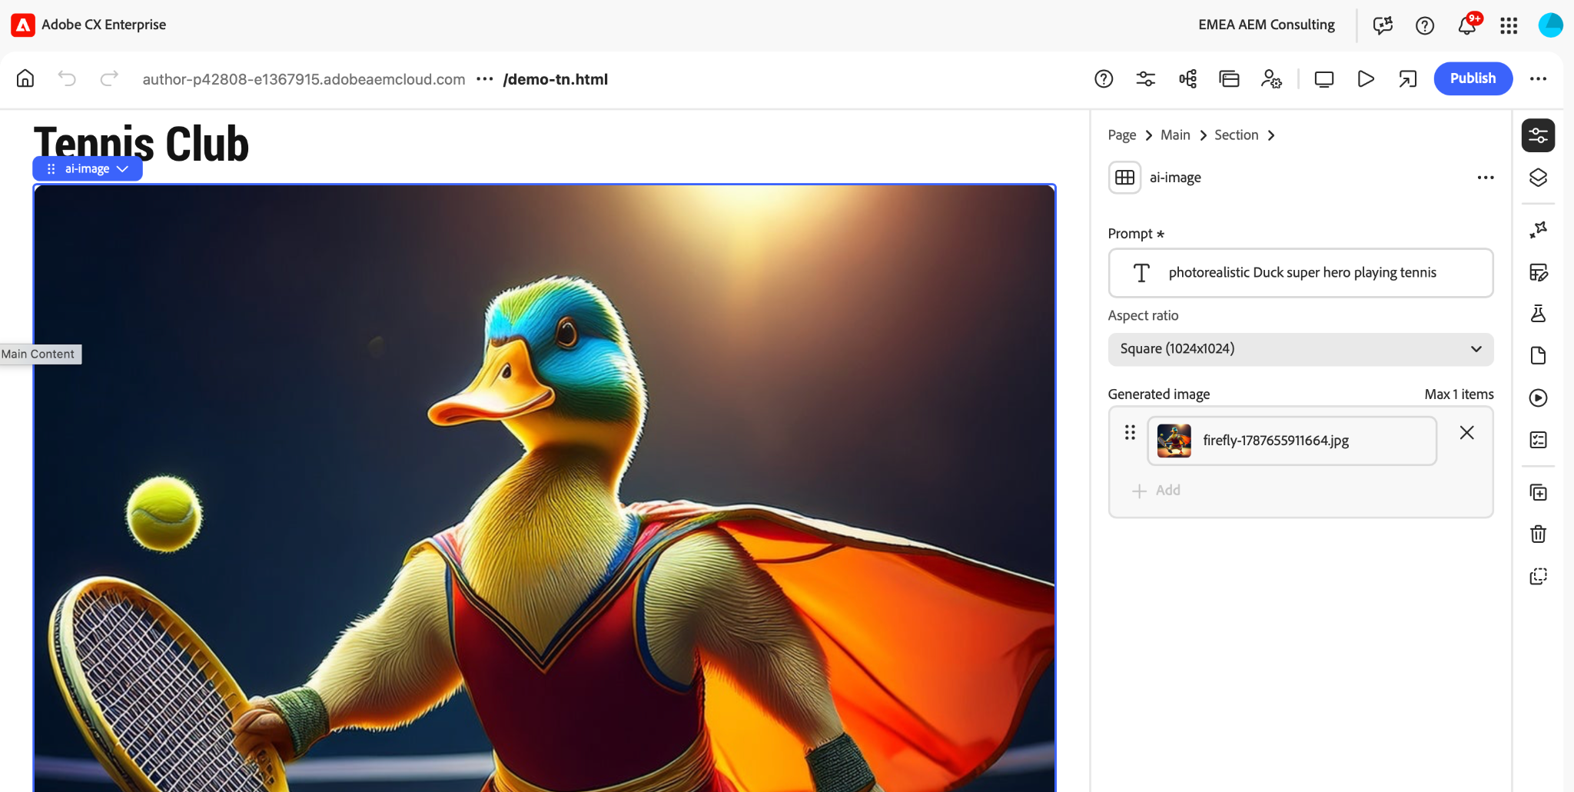
THE SERVE
The contributor writes the prompt — right where the page is authored.
No hand-off to a creative tool. No asset hunting. The visual is generated inside the block.
01 CONTRIBUTOR PROMPT
02 FIREFLY GENERATED IMAGE
The author sees the result immediately.
PROMPT → GENERATE → PREVIEW
Notes:
[Sources]
User-provided authoring screenshot: /mnt/data/Screenshot 2026-09-11 at 14.05.14.png
User-provided ai-image implementation states that prompt + aspect ratio drive generation and the generated image is persisted in AEM DAM: uploaded ai-image Block deck, lines 227–251 and 133–164.
[/Sources]

Slide 3
THE RALLY
Five touches. One clean integration boundary.
The browser never owns the Firefly secret — the Edge Function does.
1 EDS BLOCK
2 EDGE FUNCTION
3 FIREFLY API
4 AEM DAM
5 EDS PAGE
prompt + page context
secure API boundary
generate image
persist the asset
render the hero
SECRET STAYS HERE
IMS / client credentials
Same pattern works for hero generation, product variants, localization and campaign moments.
EDGE = SECURITY + CORS + API ORCHESTRATION
Notes:
[Sources]
User-provided EDS Edge Function guide describes the Worker as a secure API proxy, handling CORS, caching and secrets: uploaded EDS-EdgeFunction-Guide deck, lines 51–62.
User-provided ai-image implementation describes request path authoring → Worker → preview → DAM → persisted render: uploaded ai-image deck, lines 171–217.
[/Sources]

Slide 4




WHY CUSTOMERS CARE
One workflow. Many commercial plays.
The same integration pattern turns creative production into something closer to self-service.
HERO IMAGE
MERCHANDISING
LOCALIZATION
EXPERIMENTATION
Launch faster
More variants
Localize the scene
Test more ideas
Create the visual
where the page is built.
Seasonal or regional
without a new shoot.
Same page structure.
Different visual context.
Generate creative variants
before the next campaign.
Business result
lower visual production cost • faster time-to-market • more relevance per visitor
Notes:
[Sources]
User-provided business use cases: e-commerce/retail, marketing personalization, multi-market localization, editorial, A/B testing, real-time events: uploaded adobe-eds-firefly-use-cases deck, lines 36–54, 64–96, 106–110.
User-provided product-variant visuals: uploaded Product-Variant-Block-Firefly-Redesigned deck, lines 253–270.
[/Sources]

Slide 5
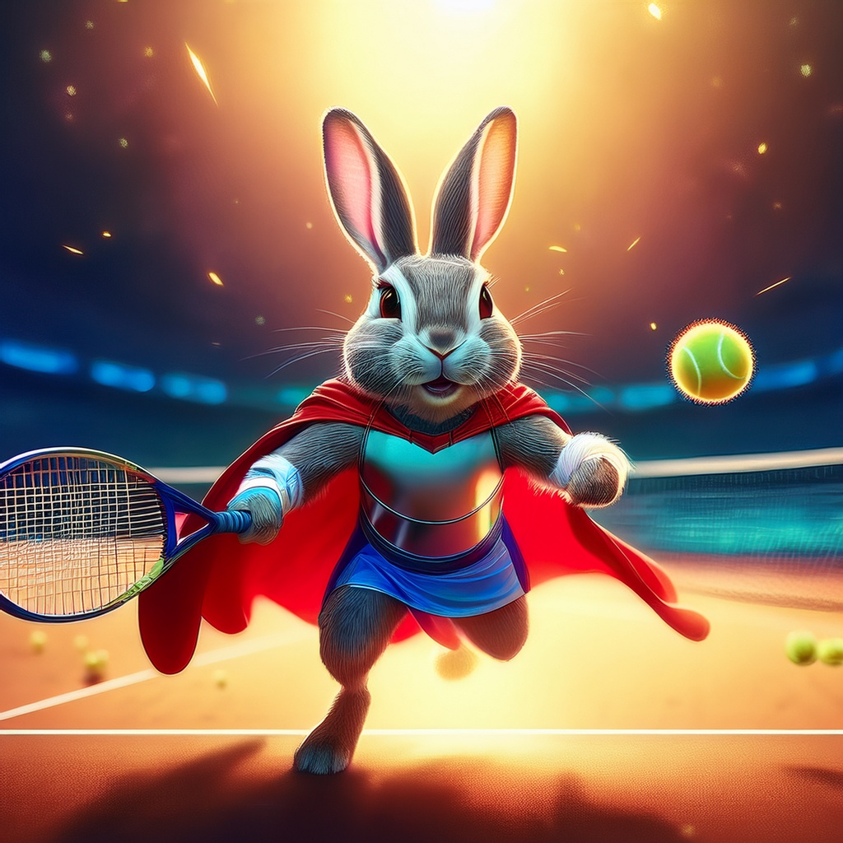
THE KEY DESIGN CHOICE
Generate once. Persist once. Render many.
That changes the economics of AI generation on a real website.
AUTHORING
PUBLISHED PAGE
Prompt
AEM DAM
“Photorealistic tennis
hero at golden hour…”
Firefly
real asset • reusable • publishable
No Firefly call
on every page view
PERSIST ONCE → RENDER MANY
Notes:
[Sources]
User-provided ai-image implementation explicitly contrasts persist-once rendering with calling Firefly on every render: uploaded ai-image Block deck, lines 133–164.
[/Sources]

Slide 6

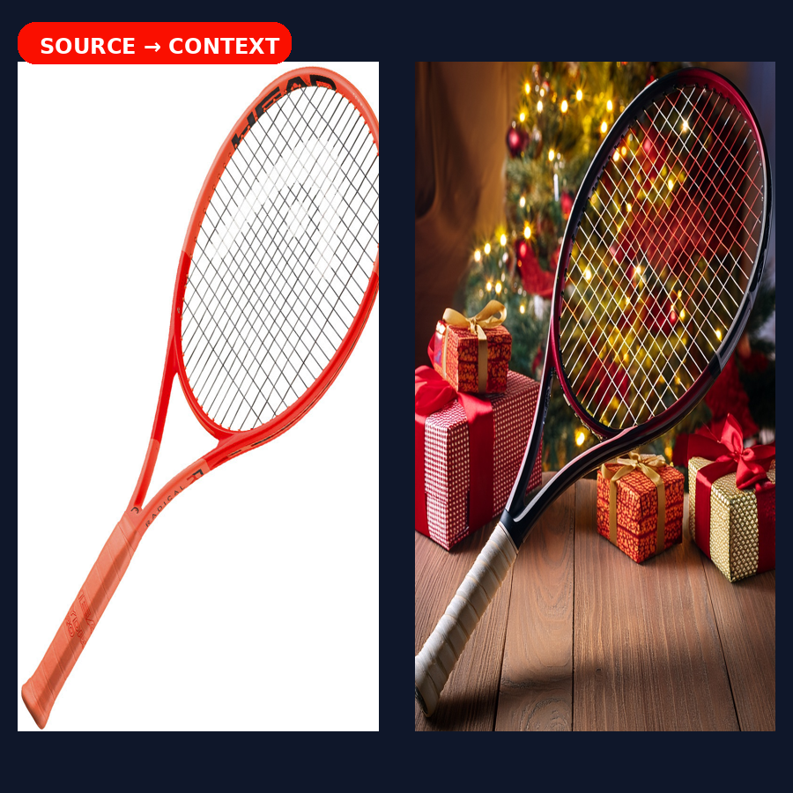
A PATTERN — NOT A ONE-OFF
Start simple. Then add context.
The first win is a generated hero. The next step is product-aware generation with Structure Reference.
STEP 1 — HERO
STEP 2 — PRODUCT-AWARE VARIANT
Contributor writes a prompt.
The block generates the page hero.
Same product silhouette.
New story for the campaign.
STRUCTURE REFERENCE
Notes:
[Sources]
User-provided Product Variant deck: source image becomes a Firefly Structure Reference and the Worker owns the Firefly call; uploaded deck, lines 86–90.
User-provided example shows one racquet generating Christmas and summer variants; uploaded deck, lines 253–270.
[/Sources]

Slide 7
LIVE DEMO
Tennis Club: let’s play it live.
Watch for three moments:
01
PROMPT
contributor describes the hero or variant
02
GENERATE
Firefly returns the visual
03
PERSIST
AEM DAM becomes the source of truth
PROMPT → FIREFLY → DAM
Then we’ll switch to the live EDS page.
Notes:
[Sources]
User-provided live authoring screenshot from the tennis sample page: /mnt/data/Screenshot 2026-09-11 at 14.05.14.png
Demo flow grounded in the user-provided ai-image implementation deck and Product Variant deck.
[/Sources]

